Slide 1
Neuromorphic Computing with Memristors
Thomas Tiotto
PhD Candidate @ Rijksuniversiteit Groningen
ISRC-CN³
28 October 2022

Slide 2
CogniGron - Groningen Cognitive Systems and Materials Centre
The mission is to develop materials-centred systems paradigms for cognitive computing based on modelling and learning at all levels: from materials that can learn to devices, circuits, and algorithms
My project aims at developing a model of short- and long-term memory using memristors

Slide 3
Guided by the principles of biological neural computation, neuromorphic computing uses new algorithmic approaches and materials that emulate how the human brain interacts with the world

Slide 4
Our brain consumes ~ 20 W of power compared to the more than 100 MW needed by a single data centre.
Within this energy envelope the brain is able to solve tasks that our best supercomputers still can’t approach
20 W
100 MW

Slide 5

Spiking neural networks (SNNs) are asynchronous, event-based and can thus achieve orders of magnitude gains in power and performance over conventional architectures

Slide 6
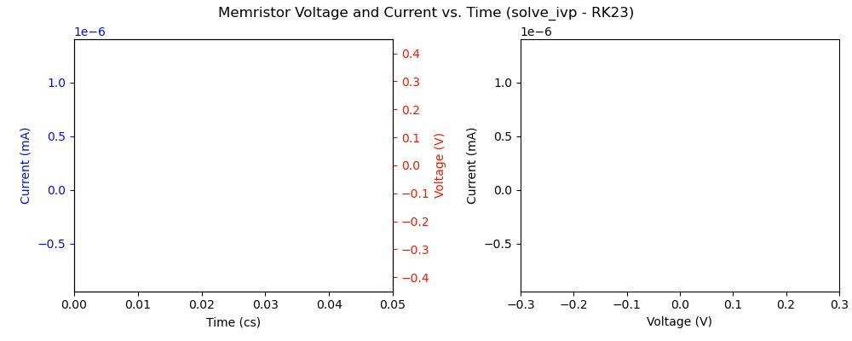

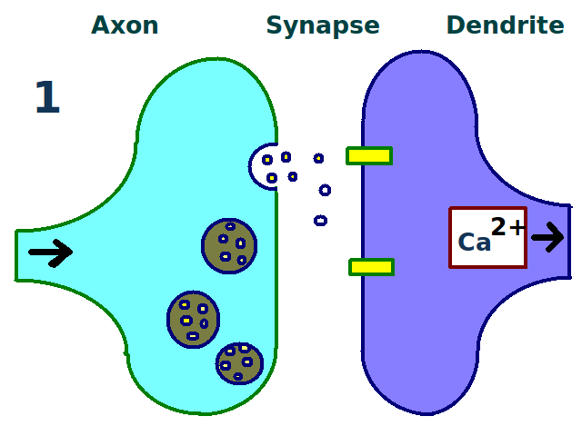
Memristors are a new class of circuit element whose characteristic is that its resistance varies in time in response to an input
They exhibit memory and can be used to emulate synapses
Voltage (V)
Current (A)
Notes:
Applying voltage pulses changes the memristor’s state
The conductance gradually increases for positive pulses and decreases for negative ones
This process can be seen as a parallel to long term potentiation and depression in biological synapses

Slide 7
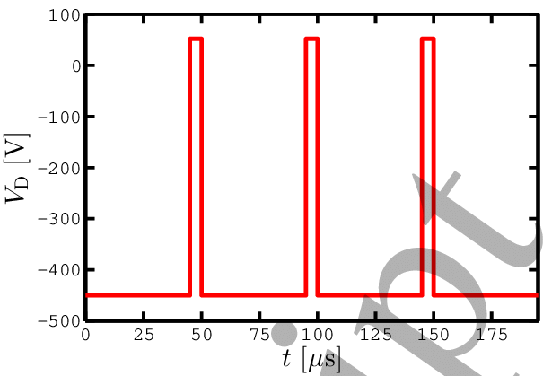
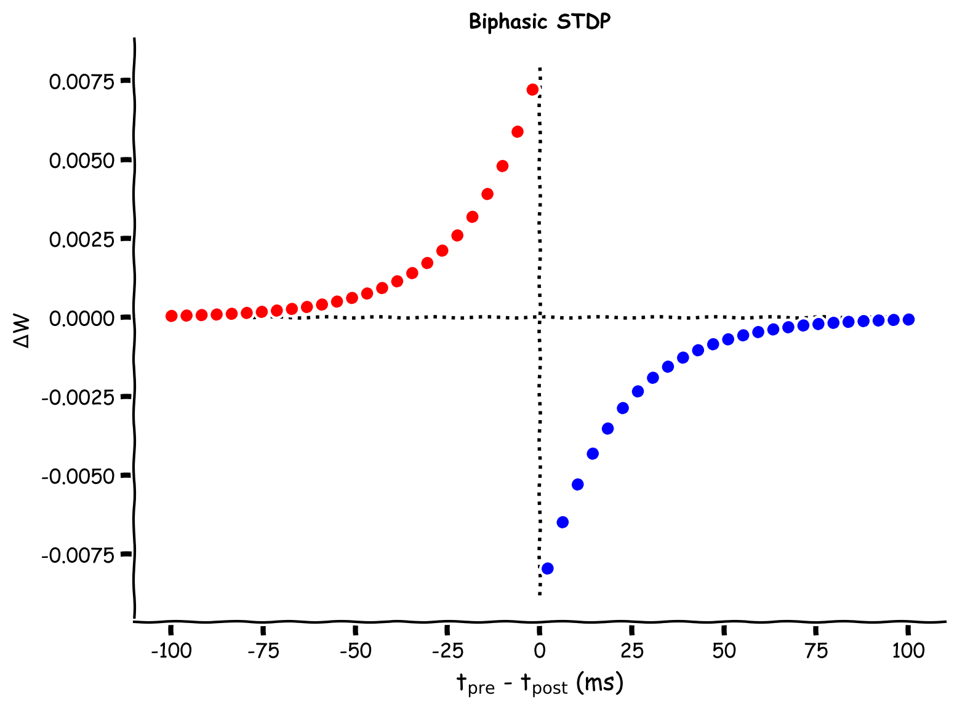
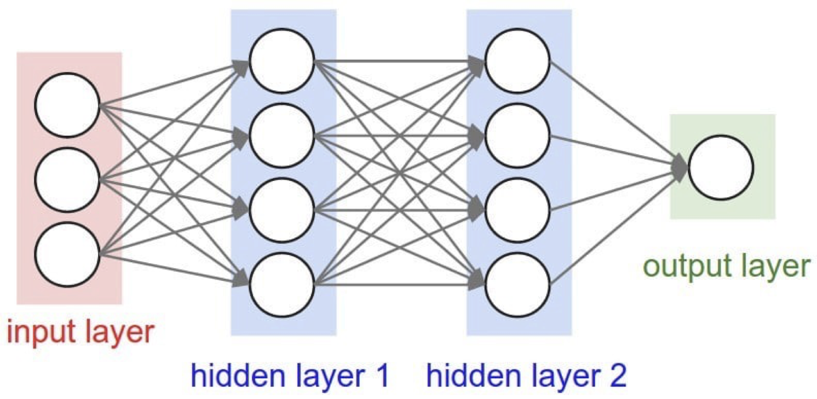
Memristors can be arranged into crossbar arrays to connect spiking neurons
We can modulate their conductances via voltage pulses in order to do analogue, low-power computing
STDP

Slide 8
Thank you for you attention

